Slide 1


Prediction of Readmission Rates in U.S Hospitals
Gayathri Sanjeev
Nathaniel Jones
Himadri Tewari
Notes:
Hello everyone, So, our project was to see if we can predict the readmission rates of patients in U.S hospitals. A 2011 survey by the Agency for Healthcare Research and Quality found that more than 3.3 million patients were readmitted within 30 days of being discharged. This survey led to questions to find out what could be done to improve patient outcomes of diabetic patients and to lower cost of inpatient care.

Slide 2


Data Source
Dataset - Health Facts database, a national data warehouse that collects comprehensive clinical records across hospitals throughout the United States.
Dataset represents 10 years (1999-2008) of clinical care at 130 US hospitals and integrated delivery networks.
Notes:
The dataset was collected from the health facts database which represents 10 years of clinical care data. The original dataset has about 100,000 rows of data. Dataset was reduced to 50,000 rows since the original one is too large. Also, another main reason is the fact that the dataset is imbalanced with more number of records of patients who were not readmitted than patients who were readmitted (9:1 ratio). This was leading to higher accuracy rates but was unable to detect readmitted patients with accuracy.

Slide 3

Data
Inpatient encounters
diabetic encounters
Length of stay at the hospital was between 1 – 14 days
Lab tests performed during the encounter
Medications administered during the encounter
Notes:
Another fact about the dataset is that the data was filtered to have only inpatient, diabetic encounters with the information of how many lab tests and medications were administered during this encounter.

Slide 4

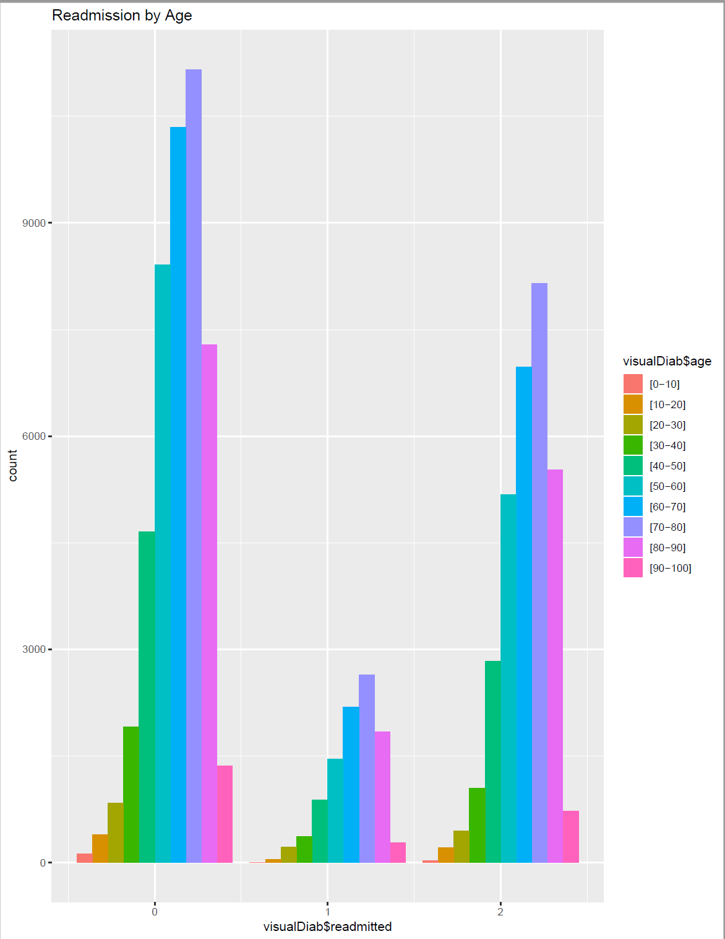
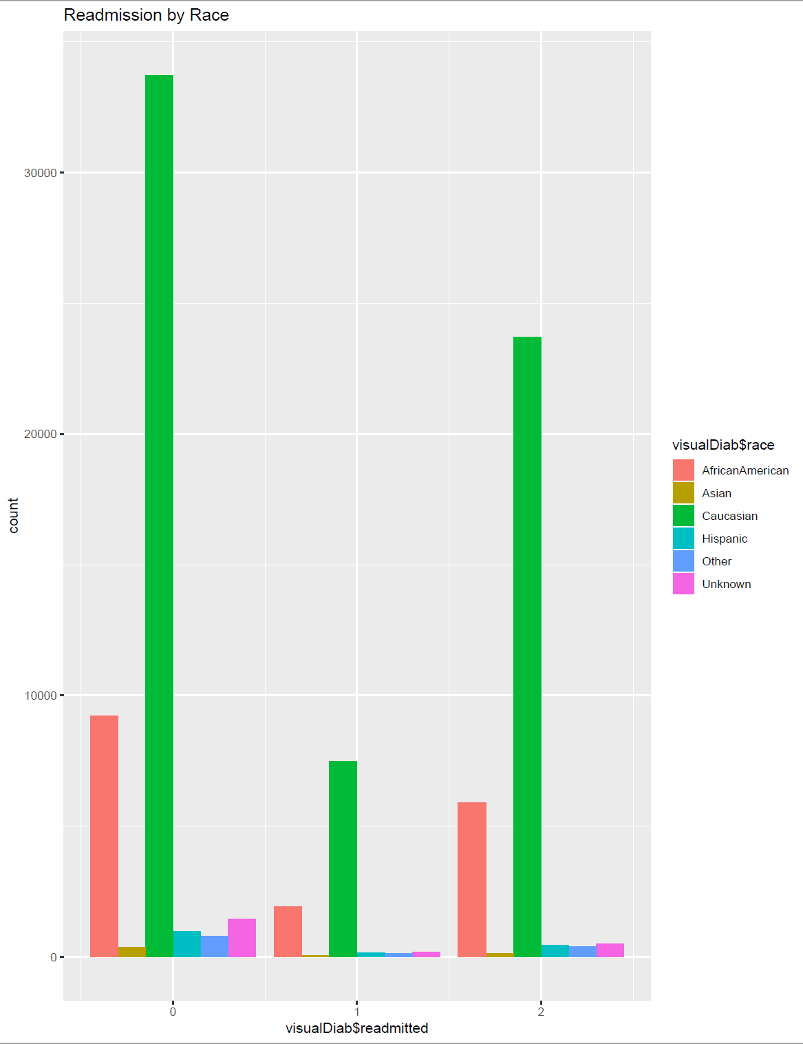
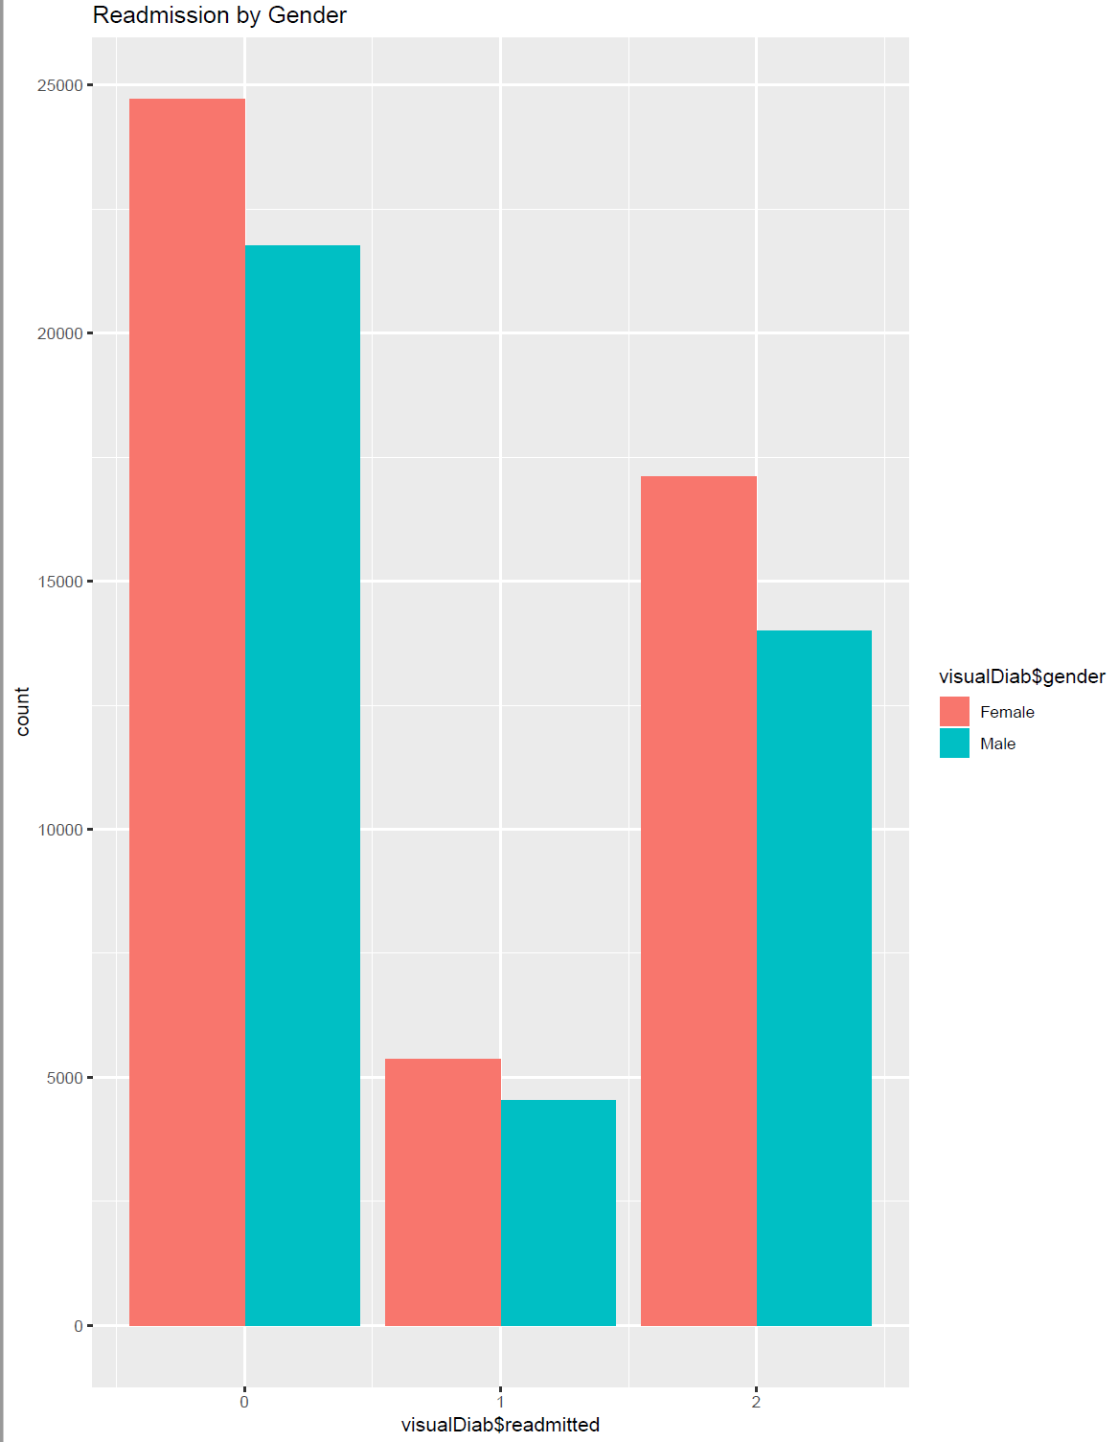
Readmission Rates By Age, Gender, Race
Notes:
0 – Not Readmitted, 1 - <30 days readmission, 2->30 days readmission – As you can see, the age group of those patients in the hospitals belonged to the age group between 70-80 years of age and the same group had a high number of readmissions and no readmissions as well. Also, the patients were mainly Caucasian and females across all ranges.

Slide 5
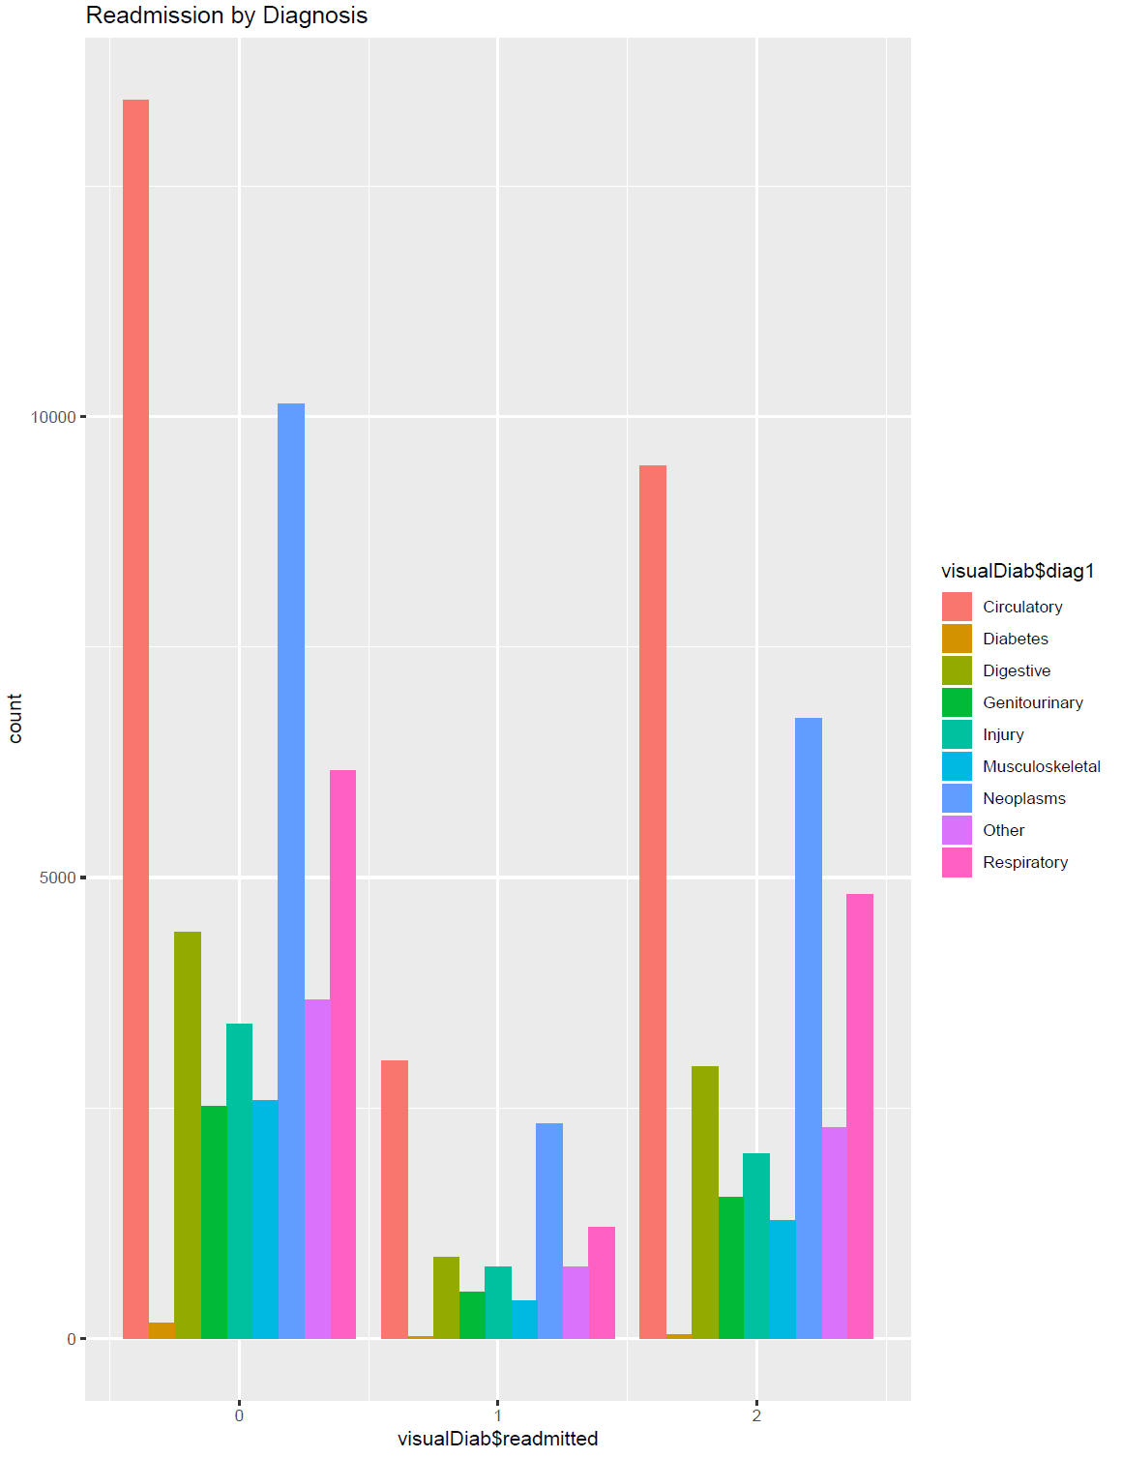
Readmission By Diagnosis
Notes:
Also, the patients who were primarily diagnosed for circulatory system were the most critical patients for readmission, the nxt highest were from the Neoplasms dept.

Slide 6
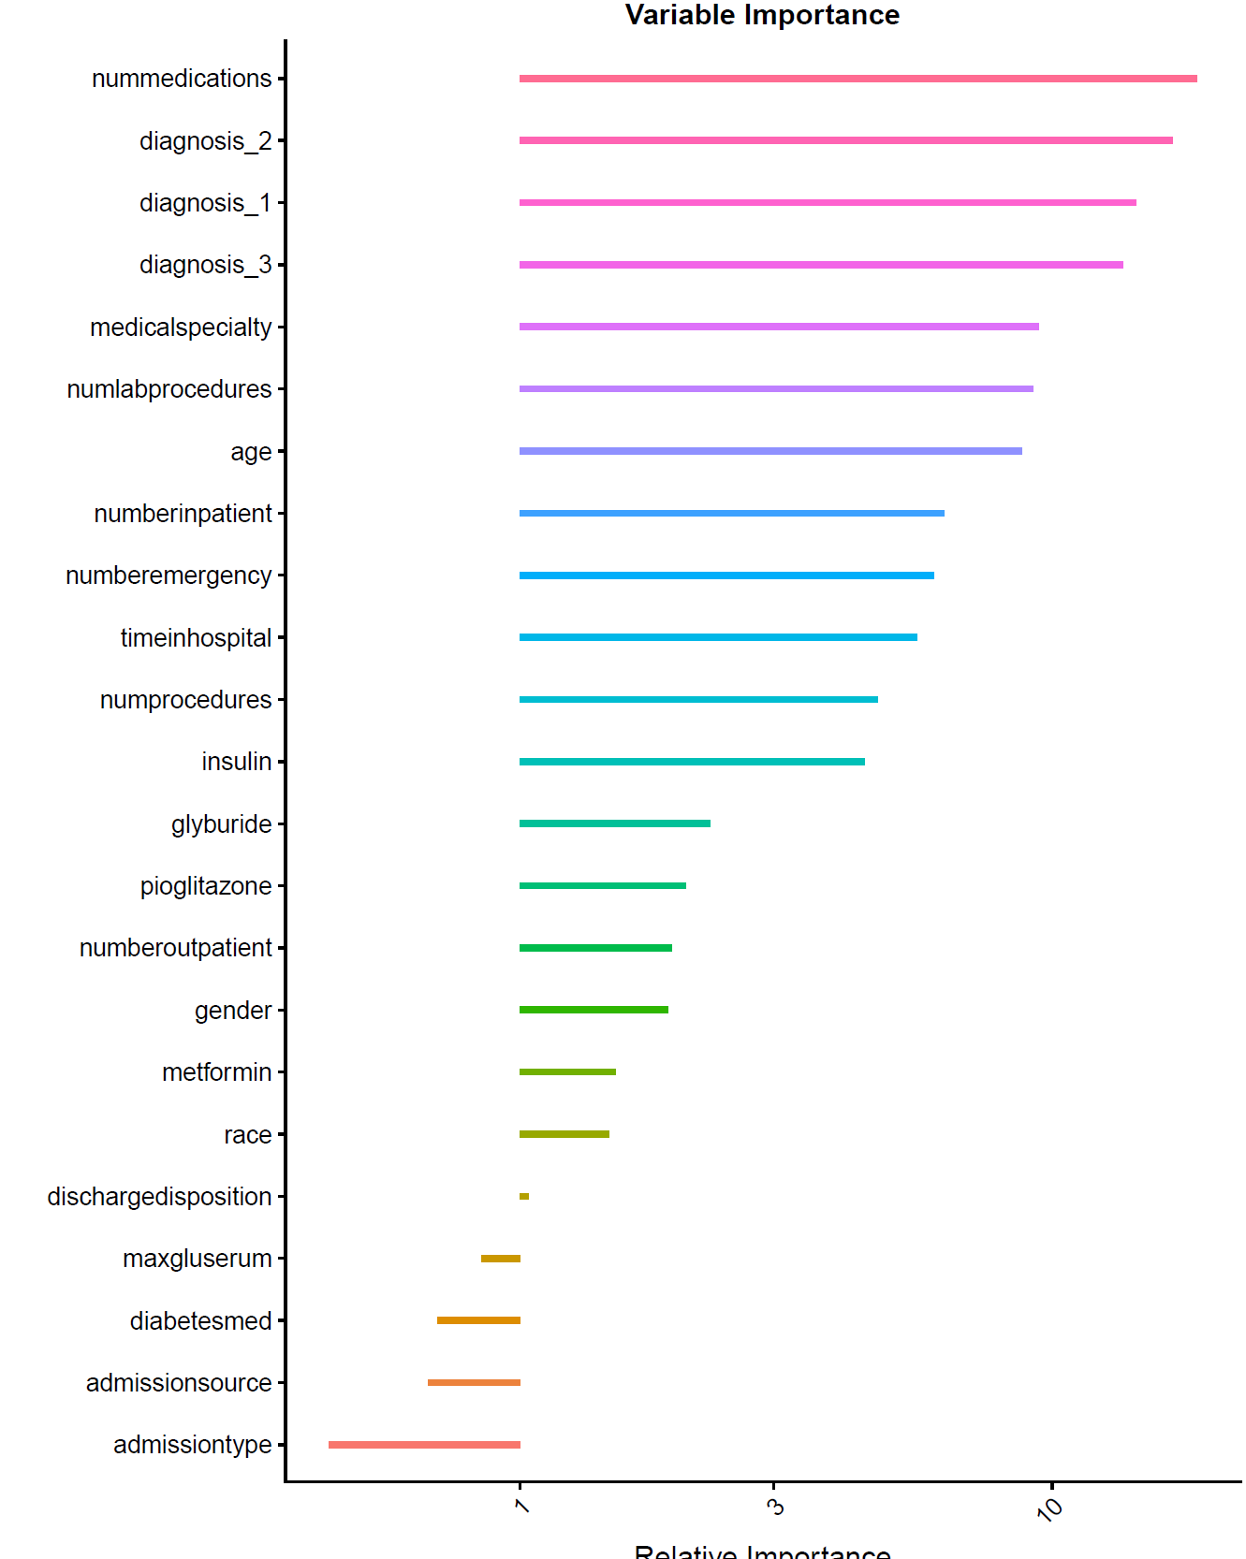
Significance of Attributes
Notes:
These are some of the significant variables we found out for the analysis. As you can see, diagnosis and num of medications administered to the patient play a significant role. And so do medical specialty meaning which dept the physician who admitted the patient is from.

Slide 7

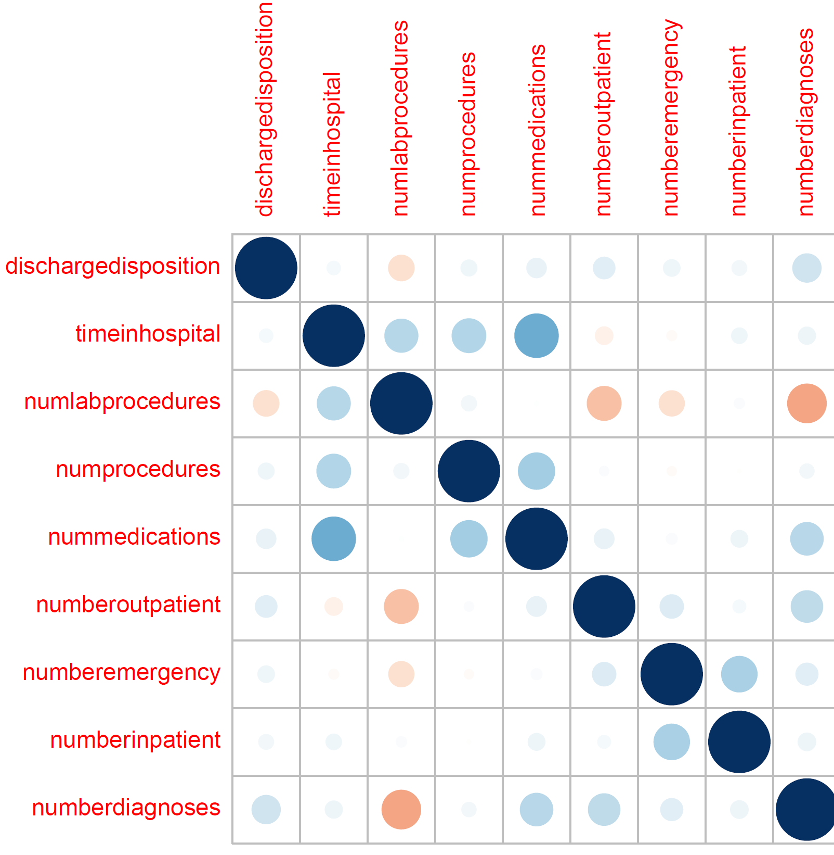
Correlations – Numeric Variables
Notes:
We also got a correlation matrix to eliminate highly correlated variables and reduce features. Correlation matrix shows a strong correlation between the variables number of medications and time in hospital showing that as the amount of time spent in the hospital increases fr the patient, the num of medications administered to the patient also increases which makes intuitive sense. So, we removed num of medications variable from further analysis models.

Slide 8
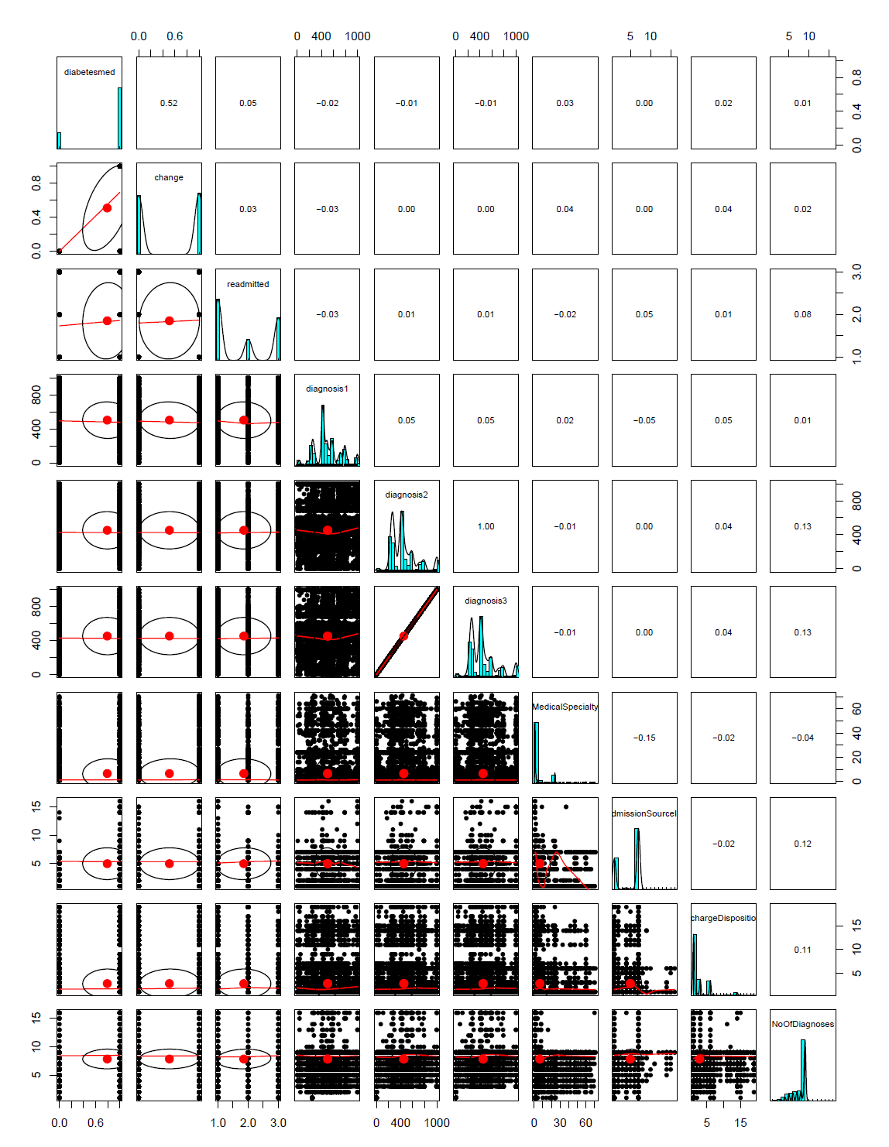
Correlation – Pair Panels
Notes:
Correlation matrix between other factor variables show that the variable diabetes medication and change have a high positive correlation of 0.52, and there is also a strong correlation between diagnosis2 and diagnosis 3 variables. So, diabetes med and diagnosis 3 variables were removed for further analysis.

Slide 9
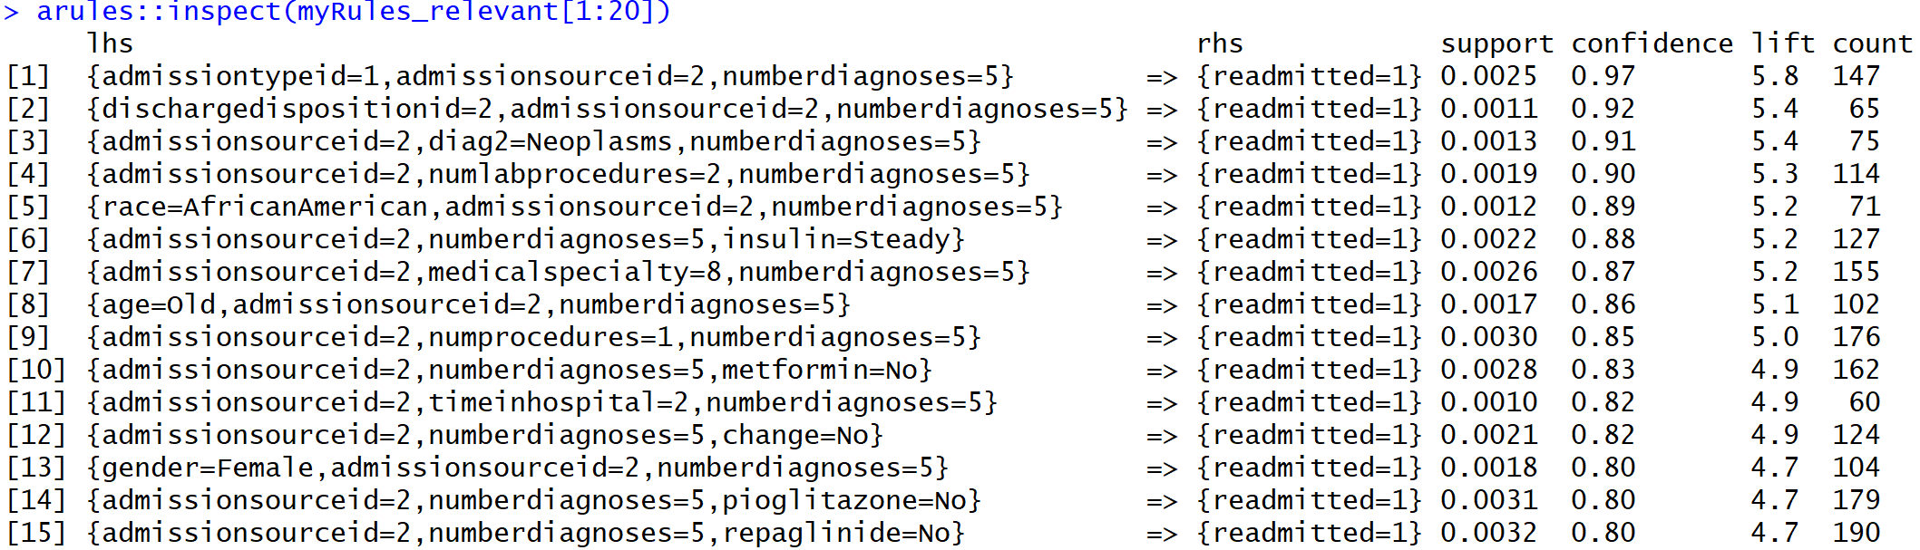
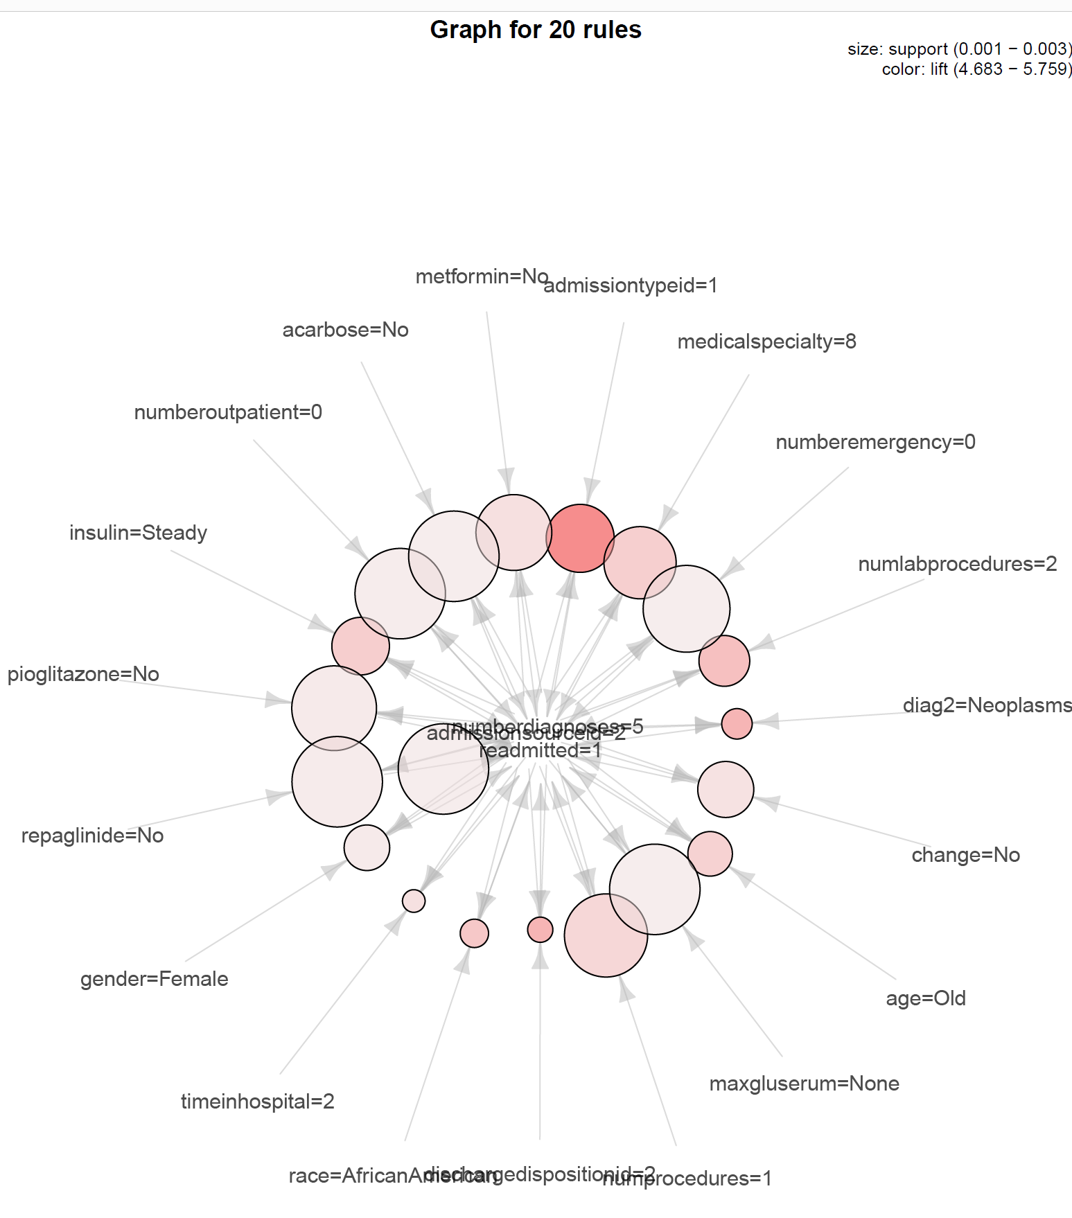
Association Rules (All Variables)
Notes:
Some other variables were also removed as part of the analysis. But, we are not going to talk about that and move on to apply Association rule mining technique on the dataset. We found out some pretty interesting rules.
#When the patient is admitted as emergency and transferred from another hospital\facility and when the number of diagnoses=5, there
#is a 97% confidence level of patients getting readmitted.
#the same also applies when the hospital discharges the patient to another hospital, 92% confidence
#when the primary diagnosis was related to the Neoplasms dept and the patient was transferred from another hospital, diag-5 --> readmitted --> 91%
#timeinhosp-6to10days, #glucose serum levels not being measured also has a significant impact on readmissions with 79% confidence
#the common thing is that when the patient is Transferred from another hospital, numofdiagnoses=5, the confidence level of readmission rate is high.
#A high lift value also shows the level of dependence of these attributes.

Slide 10
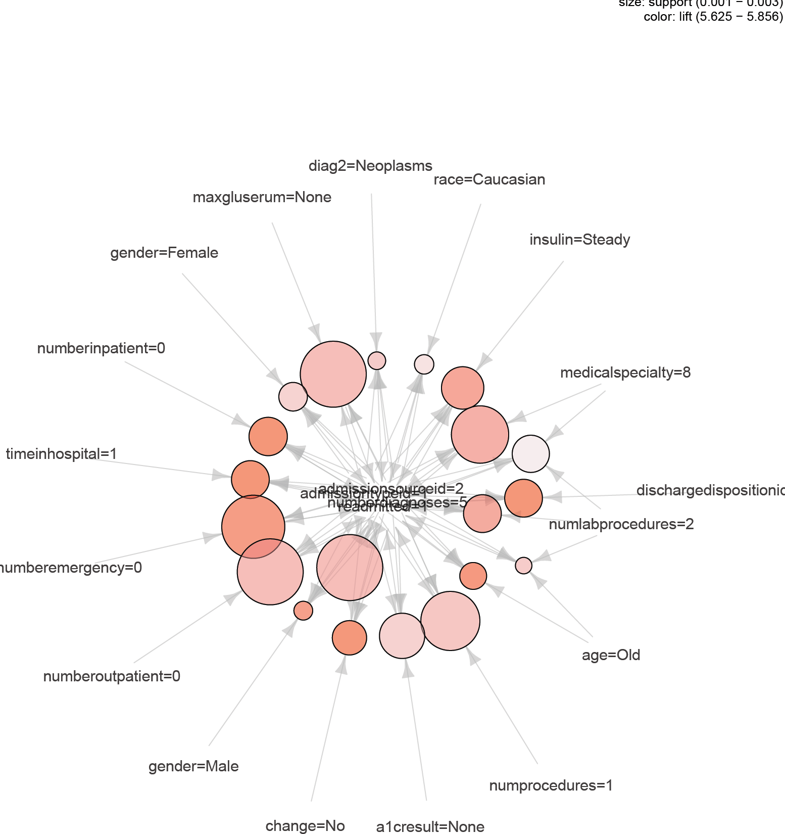
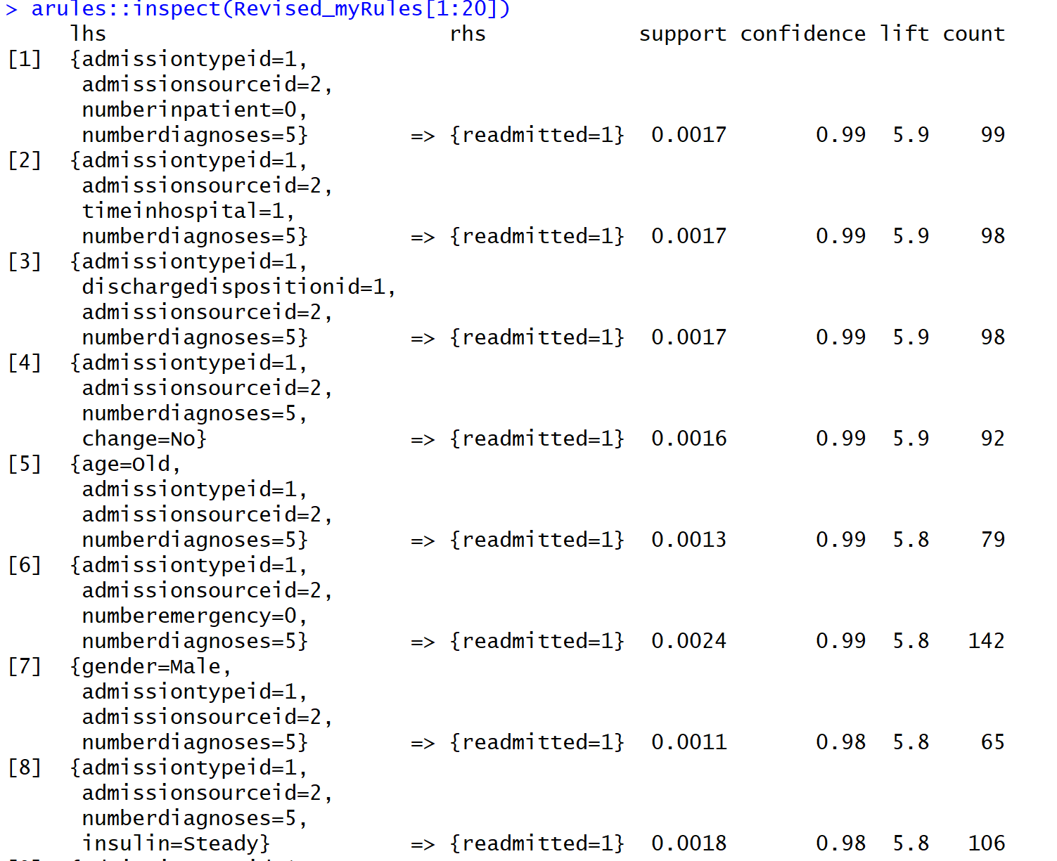
Association Rules (Without meds)
Notes:
Removed some of the medication variables that showed the dosage of meds. They were removed cos in the previous graph, the top rules showed that the medications were not administered to any of the readmitted patients, so, removed those to see if more interesting rules popped up. And, we could see that when the patient was admitted through emergency and were referred by clinics are the common patients who were getting readmitted. There’s also a strong lift and support for readmission of patients who have spent upto atleast five days in the hospital.

Slide 11
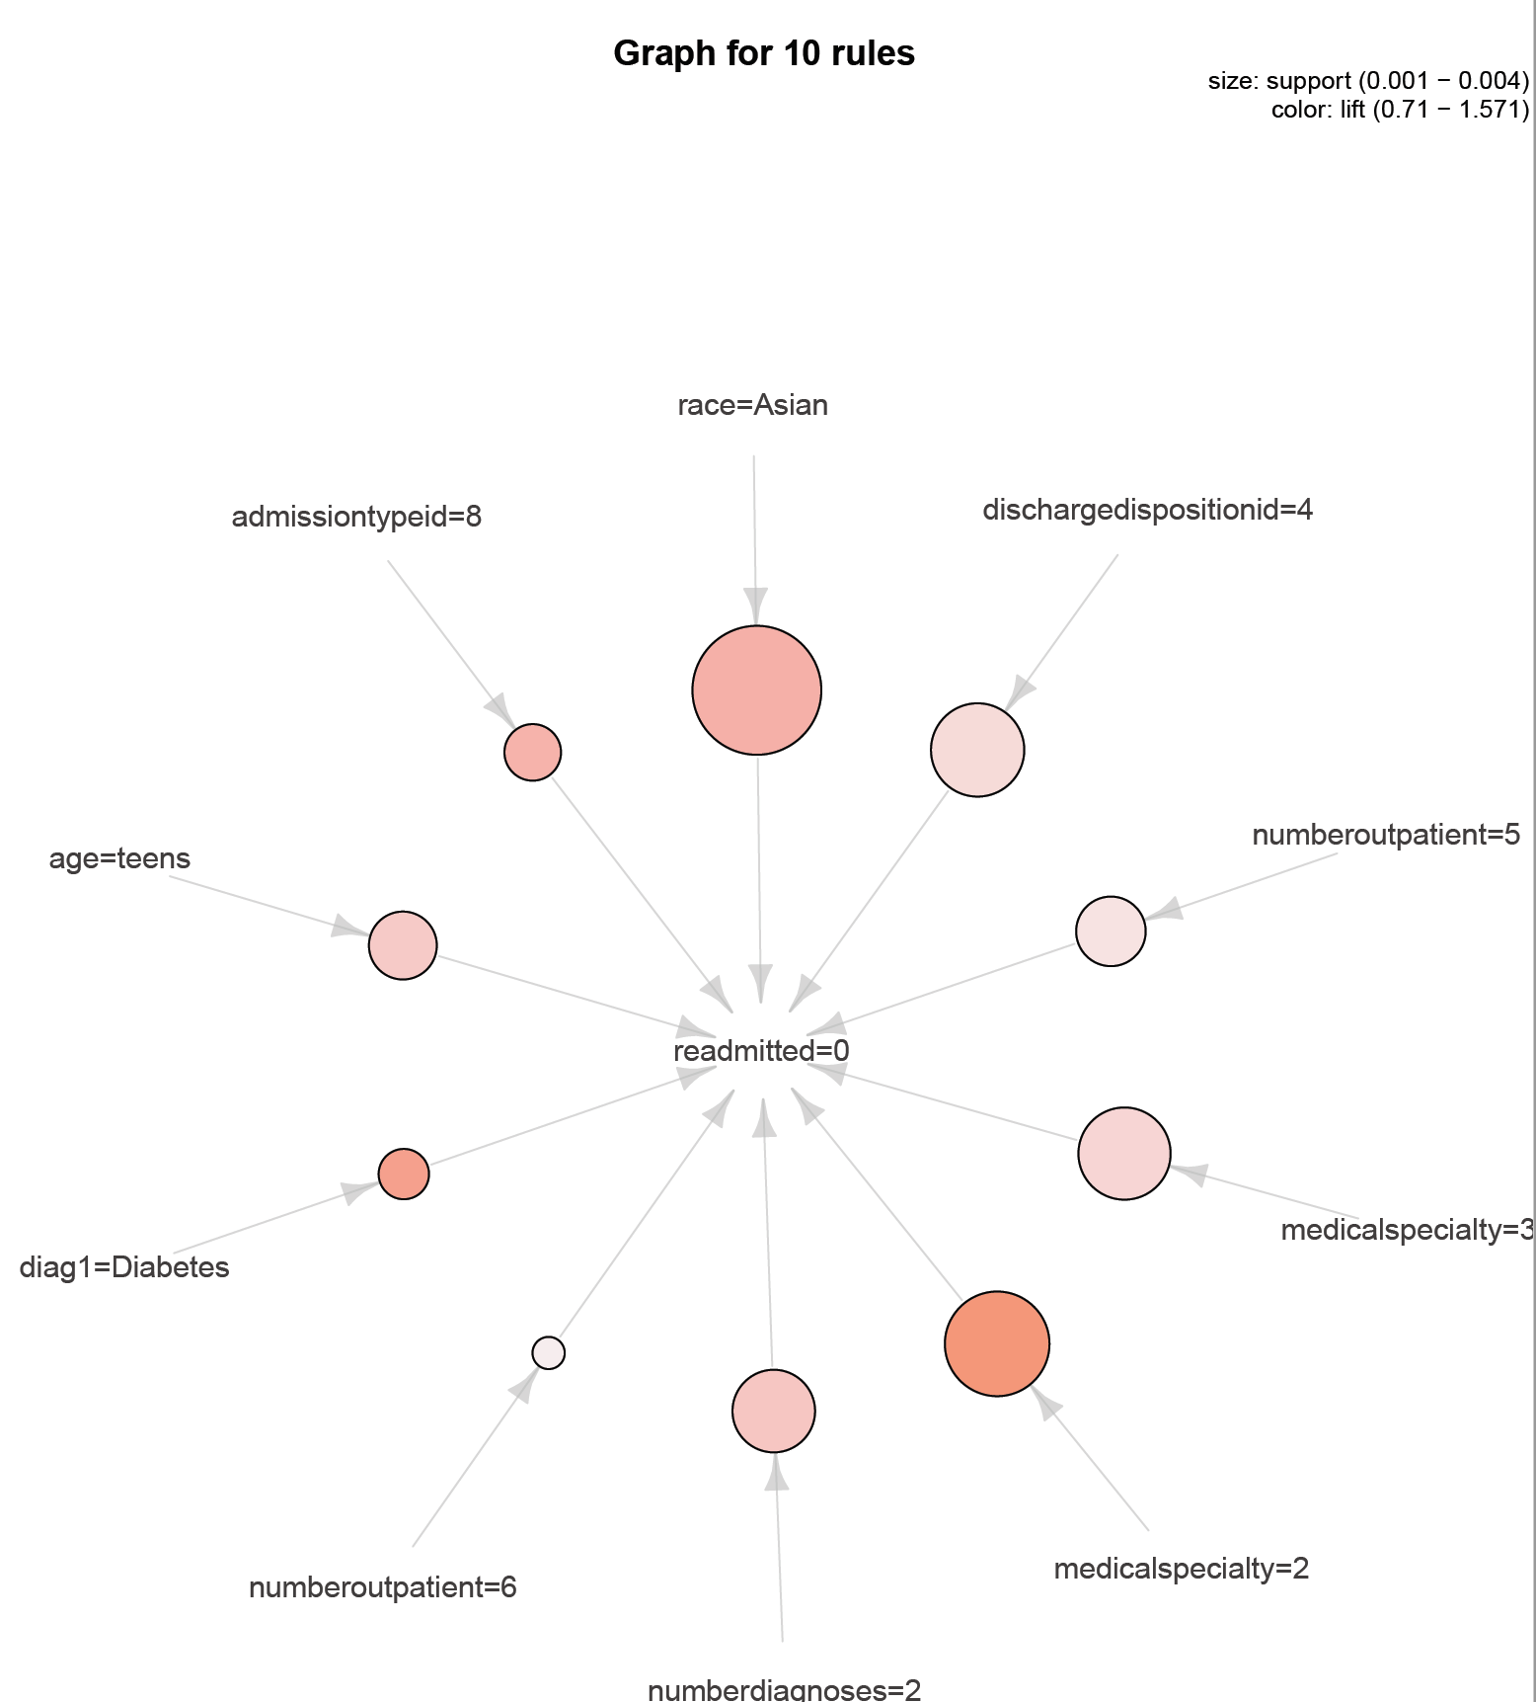
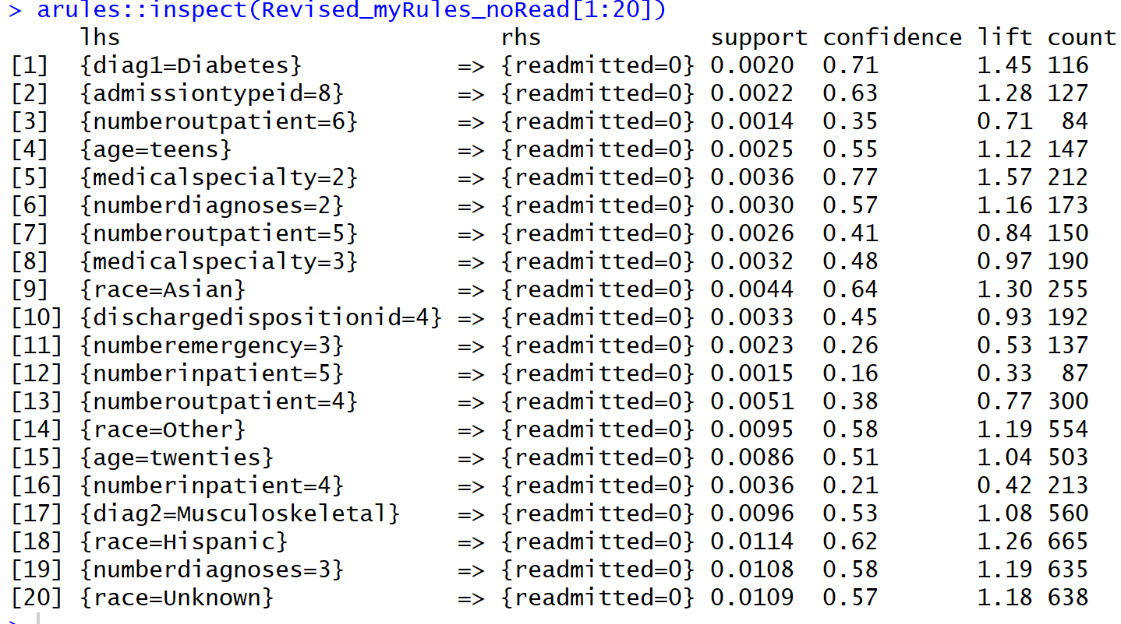
Association Rules (Without Medications) – Not readmitted
Notes:
This graph shows associations for patients who are not getting readmitted. There is a strong confidence ,support and lift for the rule which shows that patients who are admitted by a physician from Gynaec dept don’t get readmitted in the future. There is also a a strong lift and support Asian patients associated with no readmission.

Slide 12
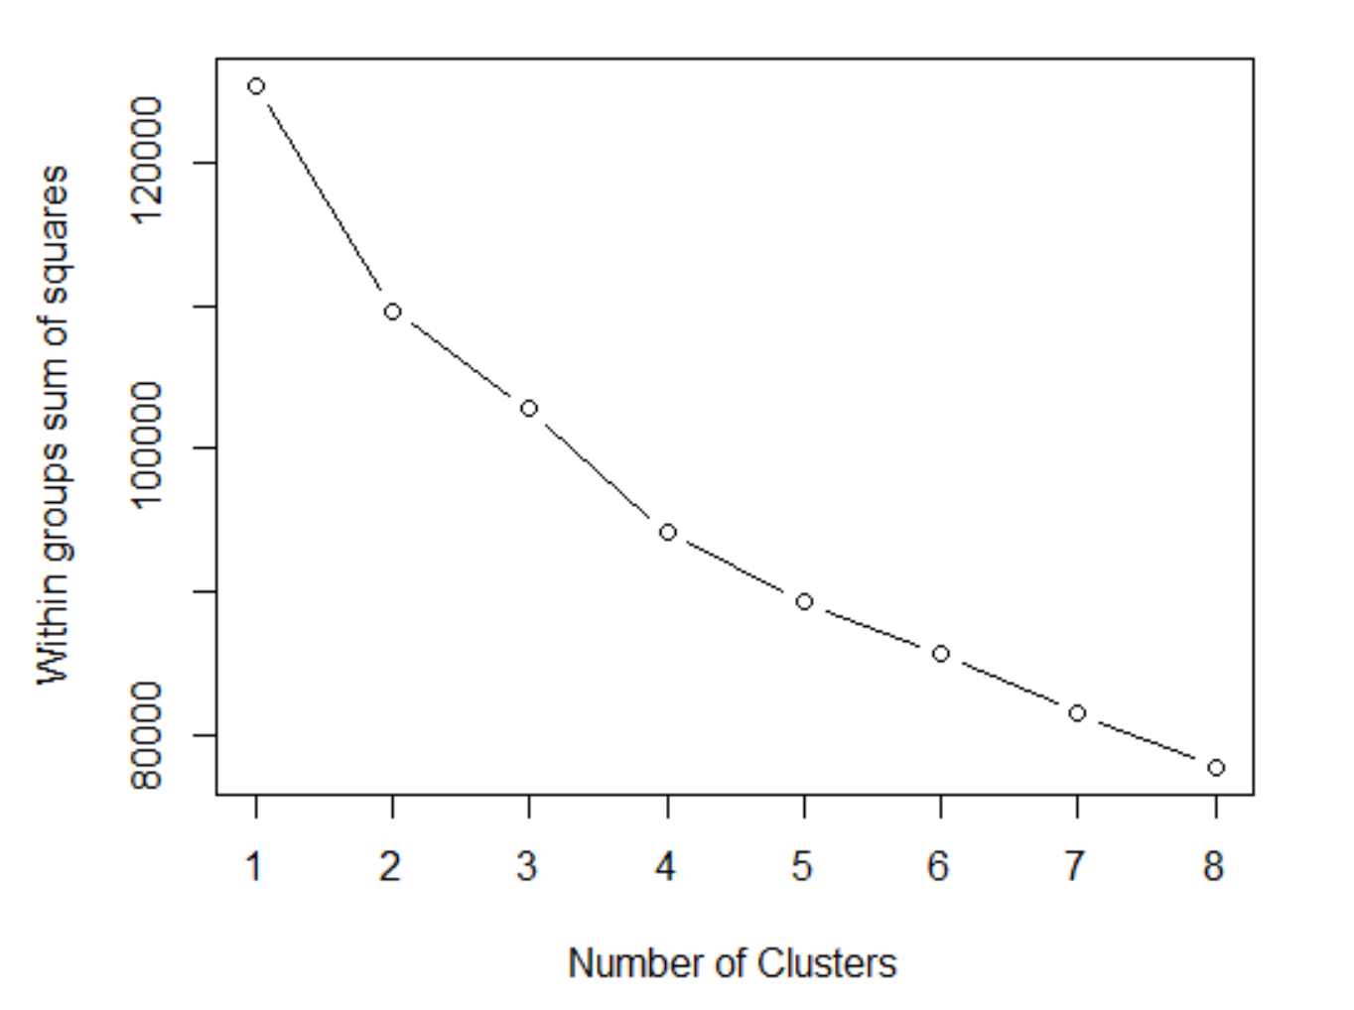
Clustering – K-means
Notes:
Next technique that we applied was K-means clustering. An Elbow plot was used to determine K. We can see from the plot that 4 or 5 is the optimal value for clustering.

Slide 13
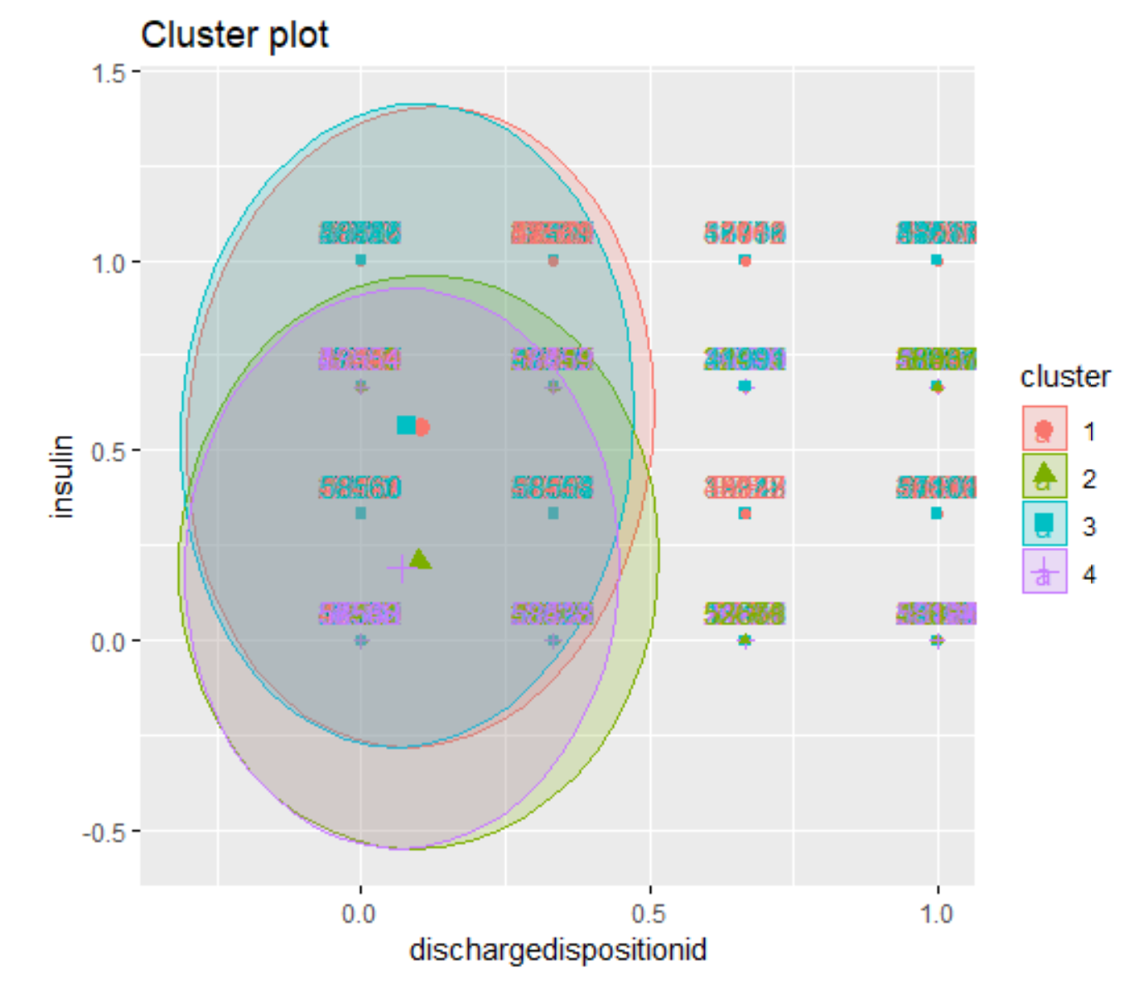
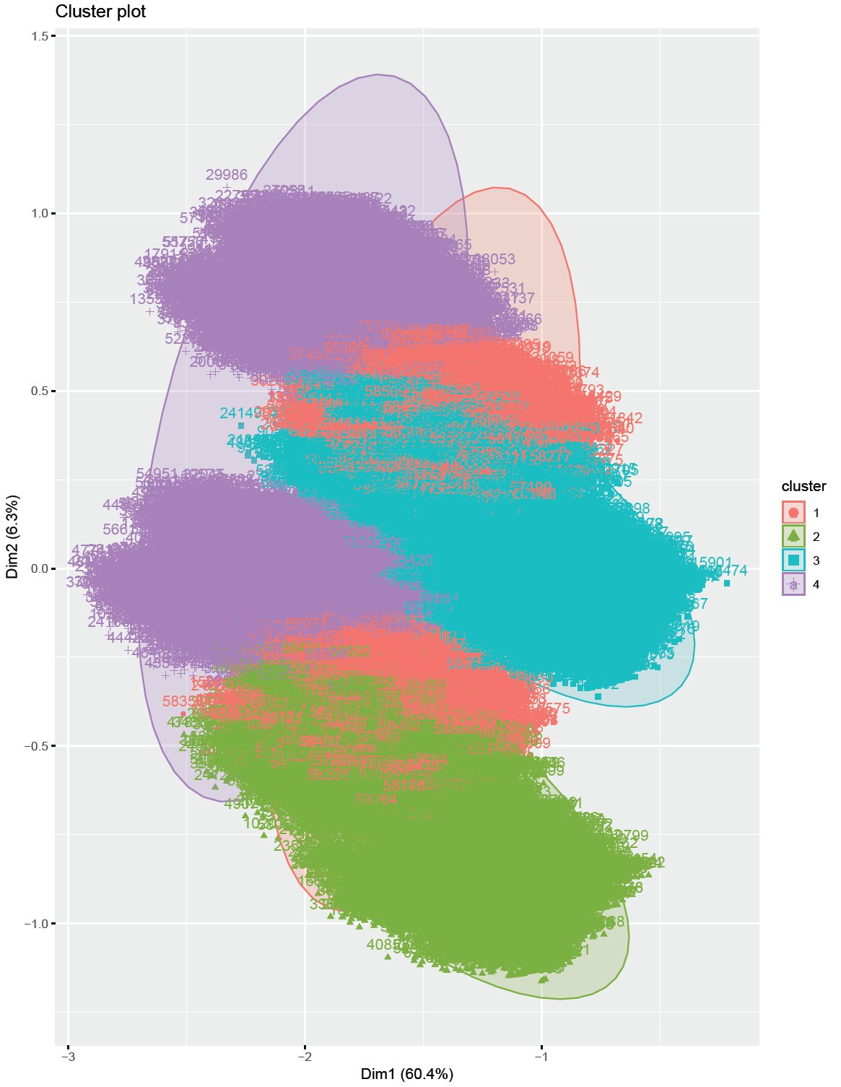
Clustering
Notes:
Since the data has overlapping information, which is explained by the overlapping clustering plots that allow a sample belong to more than one cluster. The first cluster shows the clustering between two specific variables discharge id which means where the patient was discharged to and insulin levels administered to the patient. Looks like the clusters are grouped in the lower x-axis meaning that the patients who were discharged to home after diagnosis are the ones with varying insulin levels. The second plot used PCA to reduce the dimensions into two variables that explain 66% of the variation.

Slide 14
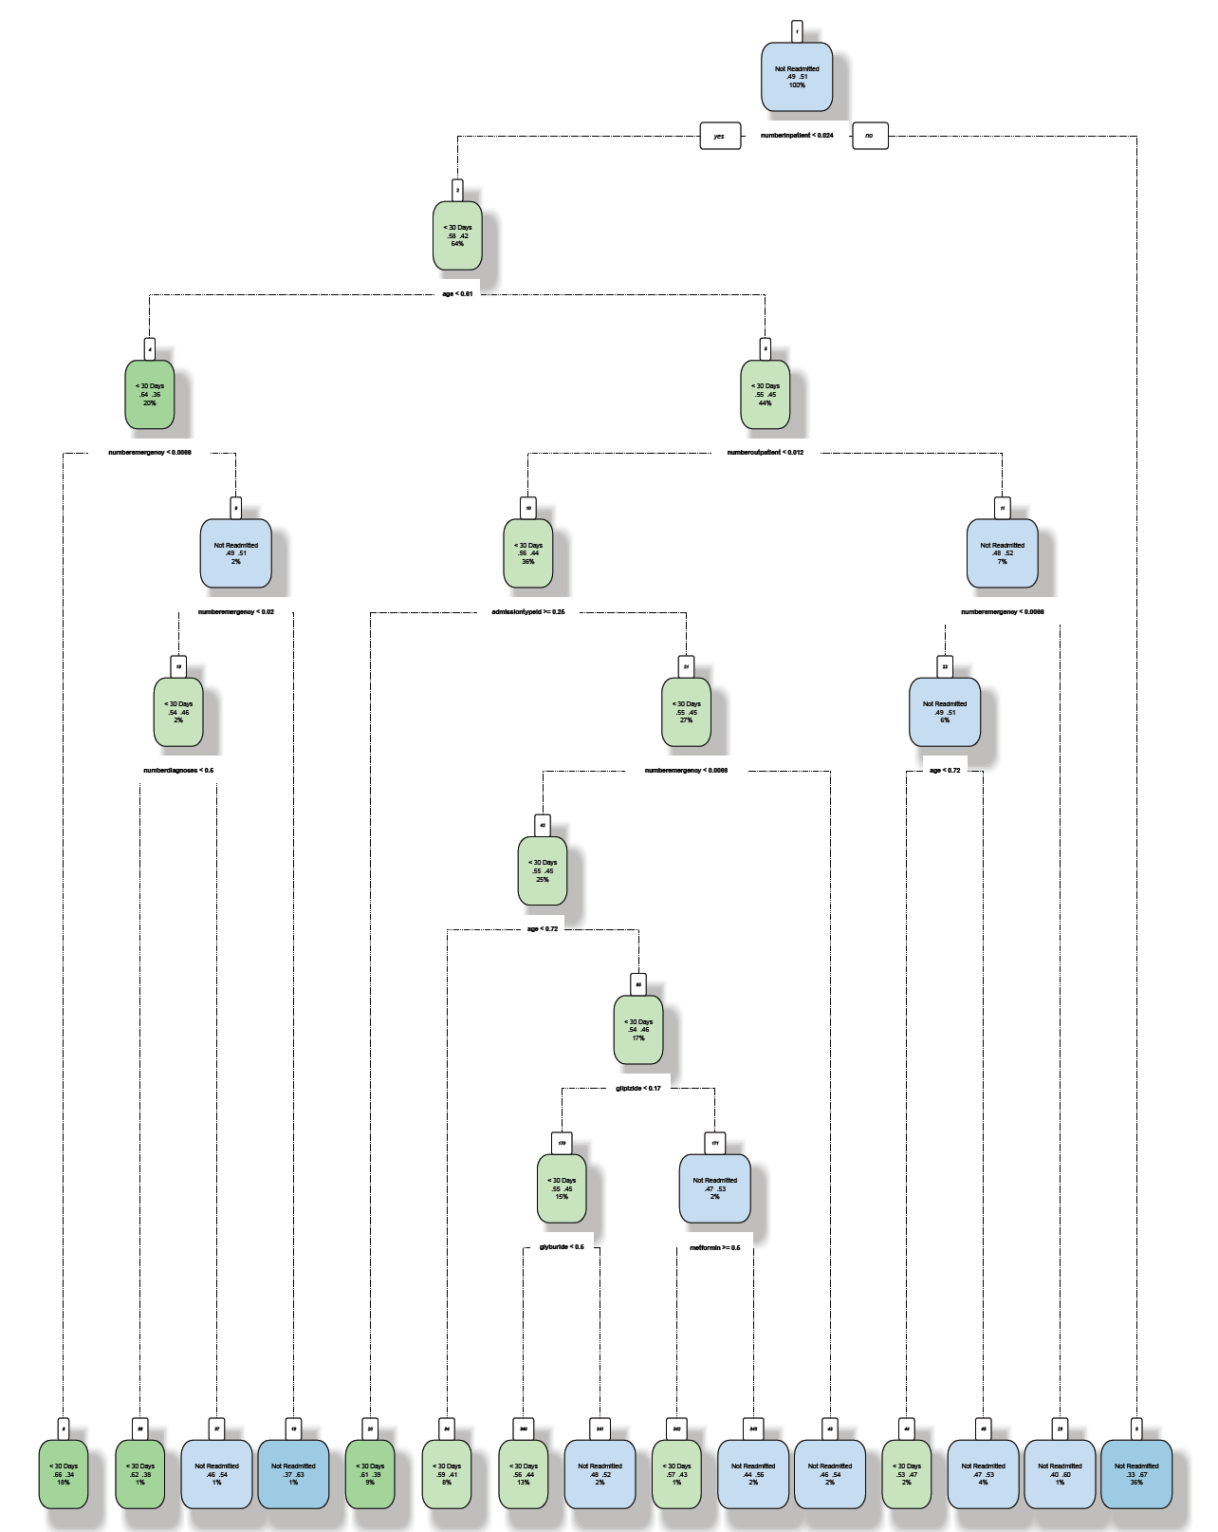
Decision Tree
Notes:
Normalized Dataset; Readmitted column has 2 factors, accuracy is 61%, kappa is 0.22 whereas Accuracy is 53%, kappa is 0.16 when readmitted is recoded with 3 factors
Categorical Dataset; accuracy is 56% and kappa is 0.11.

Slide 15
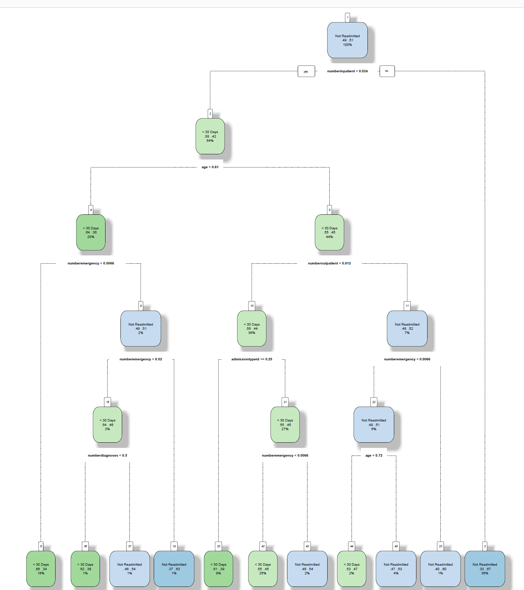
Decision Tree
Notes:
DT with fewer important variables (numberinpatient+numberoutpatient+numberemergency+age+admissiontypeid+race+
timeinhospital+numberdiagnoses+diag1+insulin+a1cresult) → accuracy improved to 61% with kappa of 0.22. After this, any other type of pruning or less variable selection did not help in better accuracy rates. Number of inpatient visits are < than 0.024 times, then there is a prob of 58% chance of getting readmitted and 33% chance of not getting readmitted. The tree is further divided on the basis of factors like age, num of emergency visits, number of outpatient visits and number of diagnoses.

Slide 16
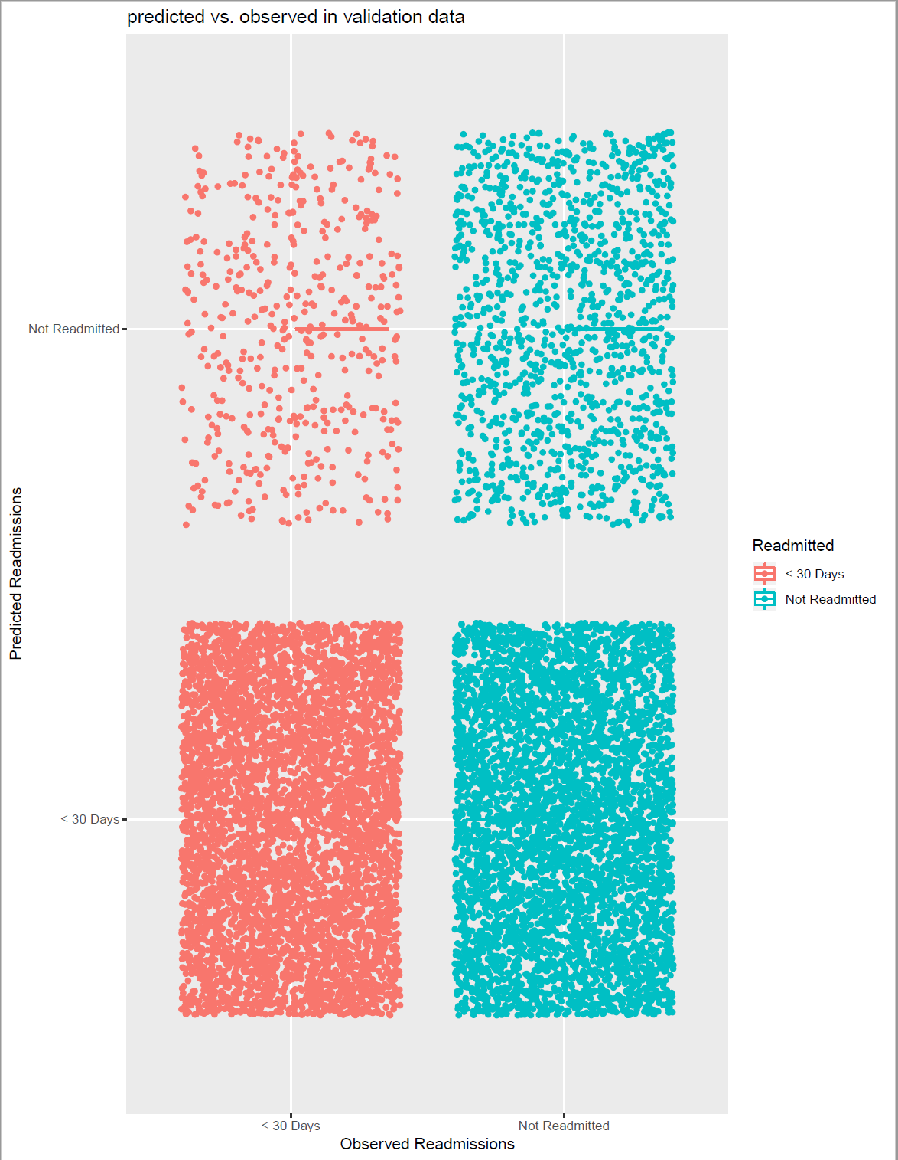
Naïve Bayes Classification
Notes:
Several functions were tried, naiveBayes from e1071 package, Naïve Bayes function from kLar package. The best accuracy with 58% accuracy was provided by the e1071 package NB function with all variables. Has less misclassifications of the readmission variable. When the number of variables are reduced or parameters were tuned, the accuracy rates go down.

Slide 17
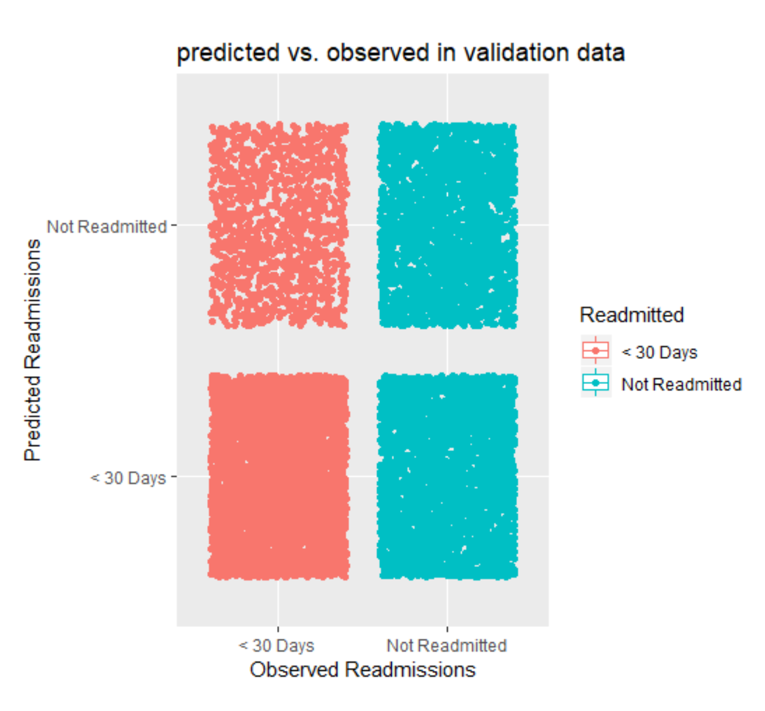
SVM Classification
Notes:
60% accuracy; more number of misclassifications in the ‘not readmitted’ column. But this performed better than the NB model. Also, the best accuracy was achieved using the linear kernel at a cost of 0.1. Different parameters of cost tuning were done but this is the best we could achieve.

Slide 18
Conclusion
Imbalanced Data
Age, Emergency admissions, Order of Glucose Serum tests contribute to readmission.

